Slide 1
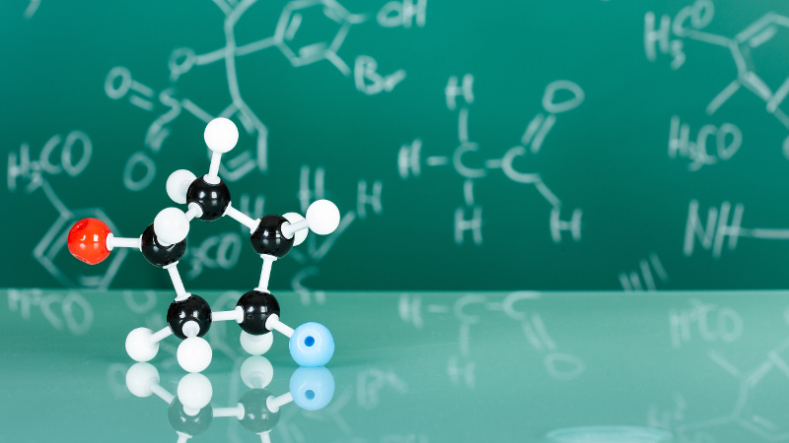
STEREOCHEMISTRY II
Dr. Palas Das
Vidyanagar College

Slide 2
R / S Configuration
Cahn-Ingold-Prelog system
Priority Sequence Rule
1. Atom of higher atomic number gets the higher priority Cl > O > C > H
2. In case of ties, consider the next atoms along the chain as tiebreakers
3. Treat double and triple bonds as if both atoms in the bond are duplicated or triplicated

Slide 3
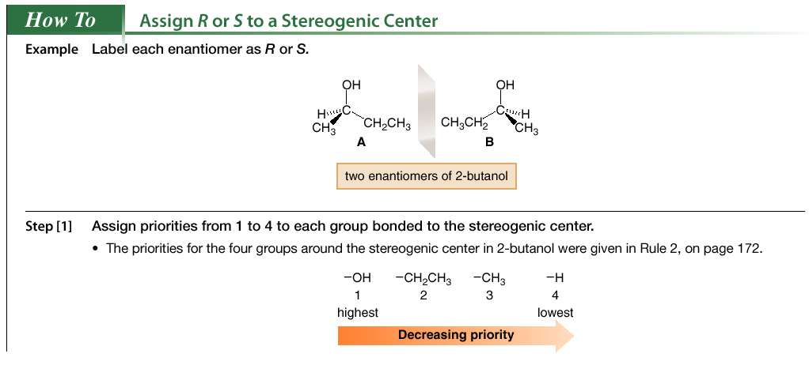

Slide 4
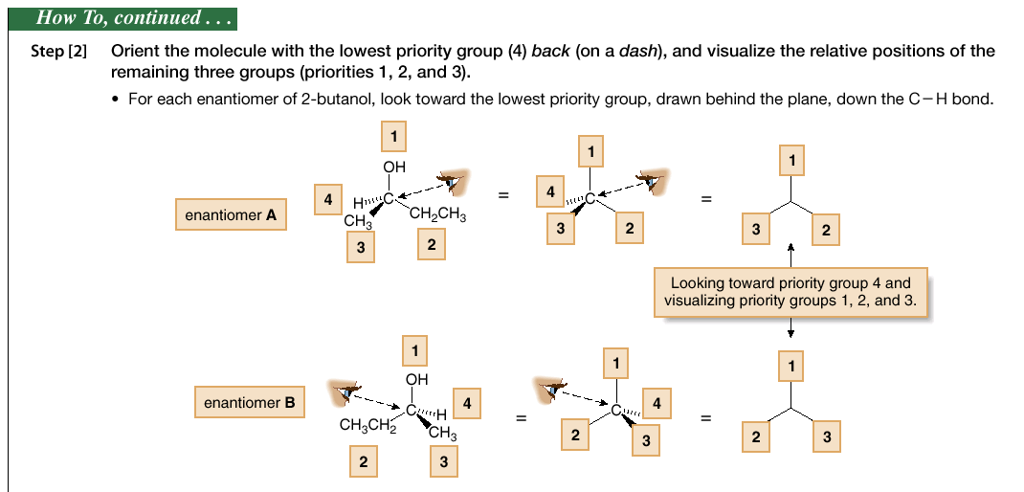
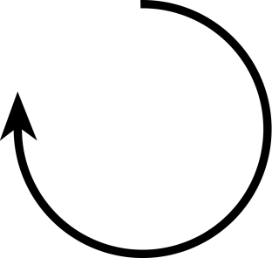
Clockwise
R
Anti-Clockwise
S
Enantiomers have exactly opposite R / S configurations

Slide 5
R / S nomenclature of 2 chiral centers
2-Bromo-3-chlorobutane
(2S, 3S)-2-bromo-3-chlorobutane
Two interchanges of groups in C2 carbon give same configuration

Slide 6
To assign R / S configuration in Fischer projection the least priority group
to be placed in vertical bottom position
i
Inter-change of groups
S-Lactic acid

Slide 7
R/S Configuration of Erythros
Sequence for Chiral C2 atom
2R
Sequence for Chiral C3 atom
2R,3R
3R

Slide 8
R/S Configuration of Threos
Sequence for Chiral C2 atom
2R
Sequence for Chiral C3 atom
2R,3S
3S

Slide 9
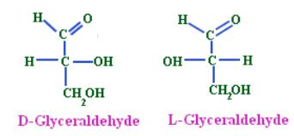
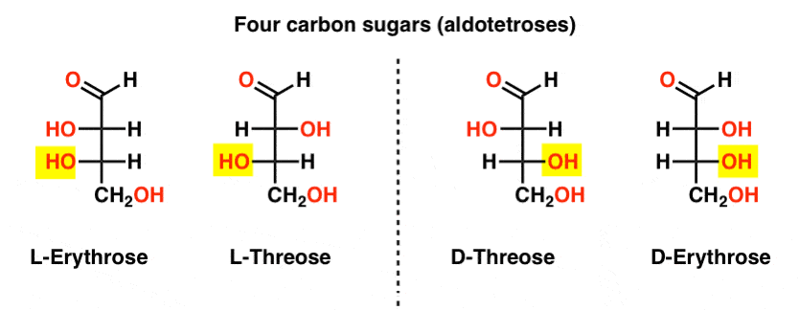
D / L Configuration
2L, 3L 2D, 3L 2L, 3D 2D, 3D

Slide 10
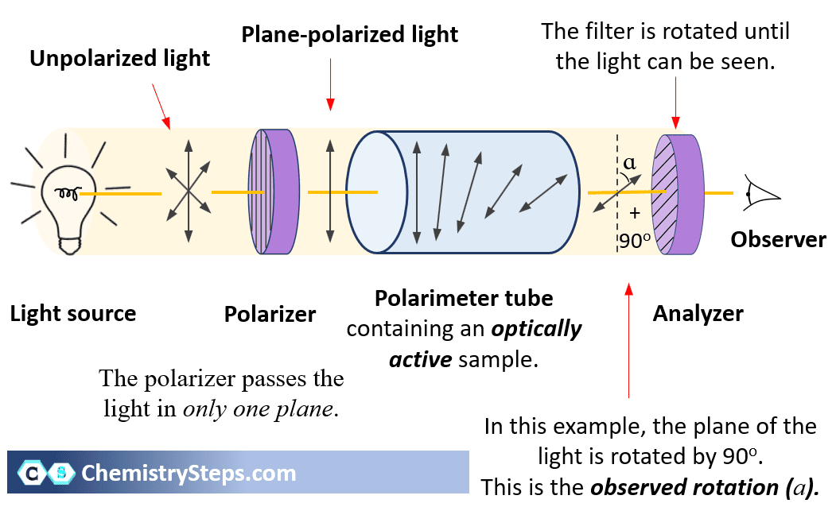
For optically inactive compound
no rotation

Slide 11
Specific Rotation
[α]_{λ}^{t} = α / l x c
α = observed rotation
c = concentration in g/mL
l = length of tube in dm
t = temperature
λ = wavelength of light
Dextrorotary designated as d or (+), clockwise rotation Levorotary designated as l or (-), anti-clockwise rotation

Slide 12
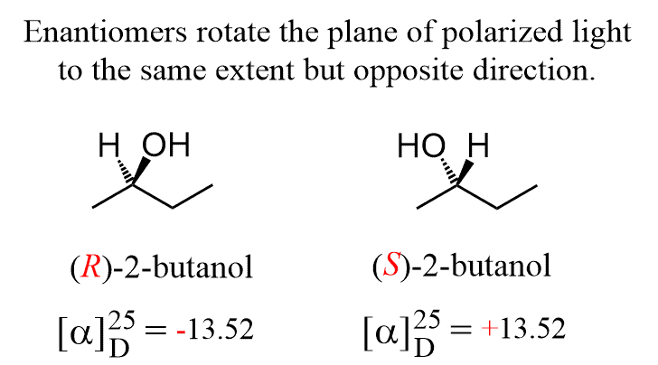
Racemic compounds
Equi-molecular (50:50) mixture of two enantiomers d & l
Denoted as (d,l) or (±)
Shows no optical activity
Racemic mixture may have different mp or bp from the enantiomers
1:1 mixture of R & S, net optical rotation [α] _{D}²⁵= 0

Slide 13
Racemisation
Racemisation is a process in which an optically active compound
(any enantiomer) is converted into racemic mixture
Racemisation through Anionic intermediate

Slide 14
Racemisation through Cationic intermediate
Enol intermediate
Optically active
+ enantiomer
Optically inactive Racemic mixture
+ & - enantiomer

Slide 15
Resolution of Racemic acid

Slide 18
Enantiomeric excess and Optical purity : ee and op
Enantiomeric excess (ee) is a measurement of the excess of one enantiomer over the racemic mixture.
ee = % of one enantiomer - % of the other enantiomer
If a mixture contains 75% of one enantiomer and 25% of the other, the enantiomeric excess is 75% - 25% = 50%. Thus, there is a 50% excess of one enantiomer over the racemic mixture.
The optical purity can be calculated if the specific rotation [α] of a mixture and the specific rotation [α] of a pure enantiomer are known.
op = ([α] mixture/[α] pure enantiomer) x 100
ee is numerically equal to Optical Purity.

