Slide 1
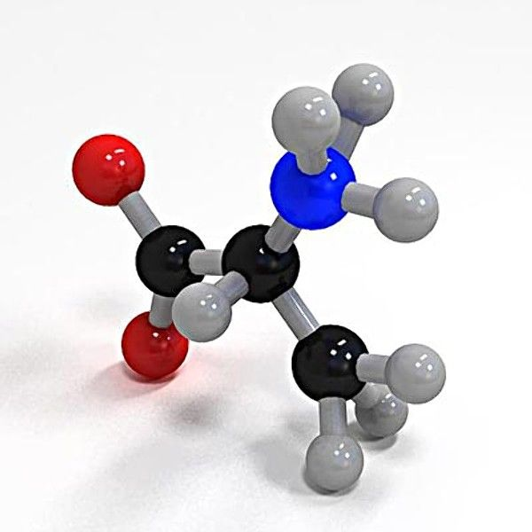
STEREOCHEMISTRY
The study of three-dimensional structure of molecules
Dr. Palas Das
Vidyanagar College

Slide 2
Isomerism
Compounds with the same molecular formula but different structures
Stereoisomer
Constitutional isomers
Conformation
Configuration
Geometrical
Optical
Trans
Cis
Diastereomer
Enantiomer

Slide 3
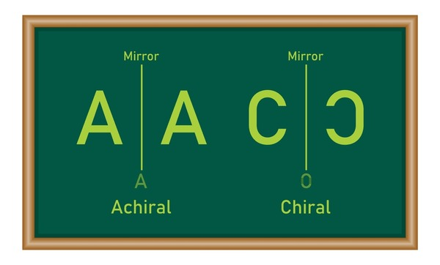
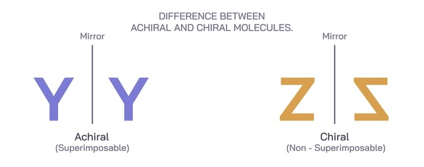
Symmetry vs Asymmetry

Slide 4
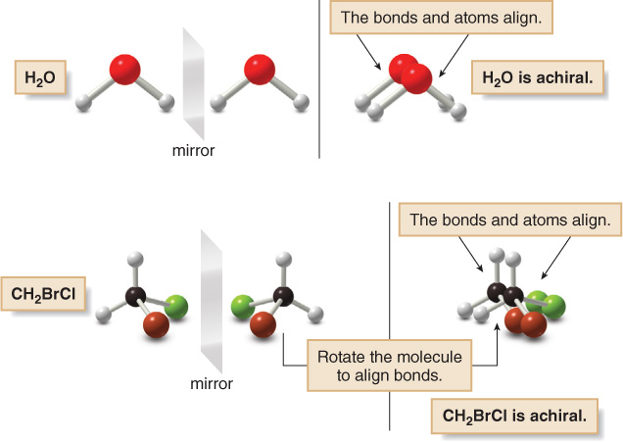
ACHIRAL

Slide 5
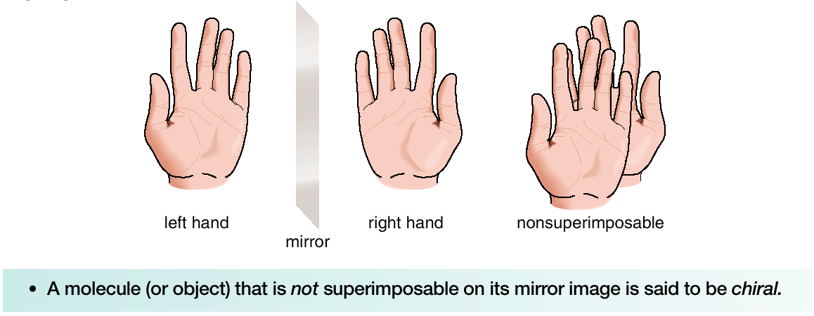
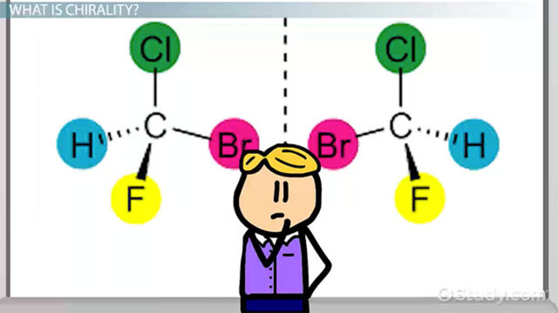
CHIRAL ITY

Slide 6
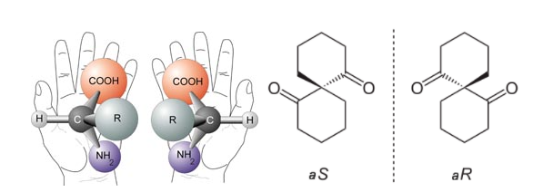
Asymmetry Chirality

Slide 7
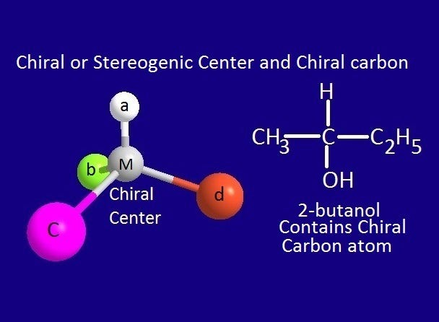
Stereogenic Center an atom on which an interchange of any two atoms or groups result in a new stereoisomer
When the new stereoisomers is an enantiomer, the Stereogenic center is called Chiral Center

Slide 8
Projection formula
Molecules can be visualized and represented on a paper
by several projection formulae
1. Flying-Wedge Projection
2. Fischer Projection
3. Saw-horse Projection
4. Newman Projection

Slide 9
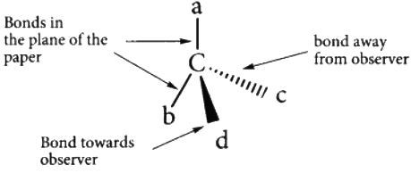
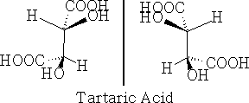
Flying Wedge Projection

Slide 10
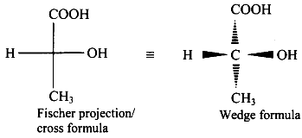
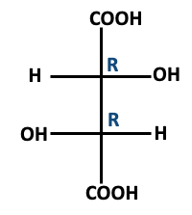
Fischer Projection
A two dimensional representation of a
Three dimensional molecule
For more than one stereo centre fully eclipsed conformation is drawn

Slide 11
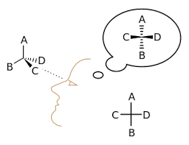
Flying Wedge to Fischer Projection

Slide 12
Fischer to Flying Wedge Projection

Slide 14
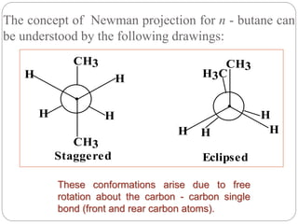
Newman Projection

Slide 15
Newman to Fischer Projection
Convert Newman to Sawhorse projection first, then to Fischer

Slide 16
Symmetry Elements
1. σ Plane of Symmetry
2. Cn Axis of Symmetry
3. Centre of Symmetry i
4. Sn Alternating Axis of Symmetry

Slide 17
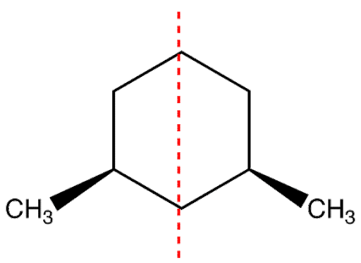
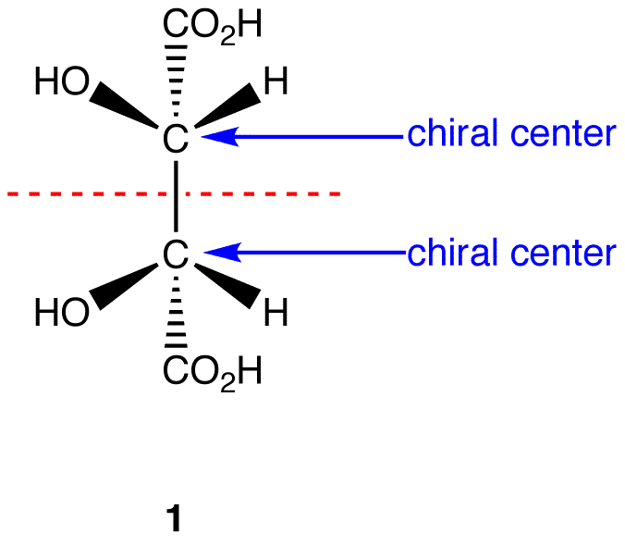
σ Plane of Symmetry
Imaginary plane that bisects a molecule into equal halves
Meso-Tartaric acid

Slide 18
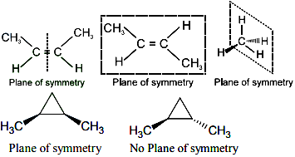
σ Plane of Symmetry

Slide 19
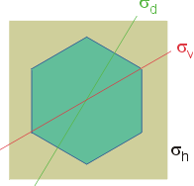
Three types of σ Plane of Symmetry for Cyclohexane
Vertical Plane of Symmetry σv
Dihedral Plane of Symmetry σd
Horizontal Plane of Symmetry σh

Slide 20
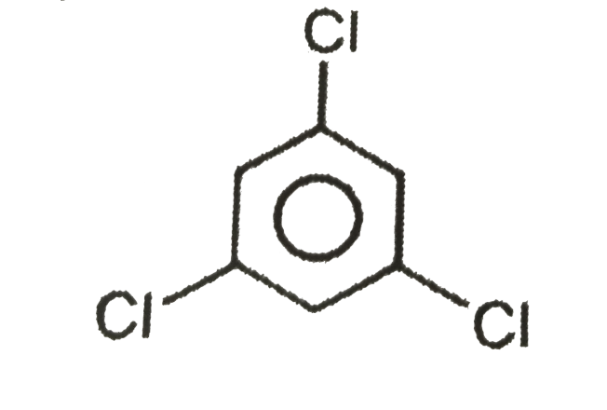
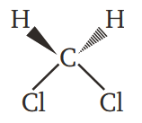
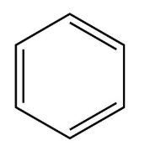
Cn Axis of Symmetry
Rotation about an axis through an angle
of 360° coincides with itself n times
C3 / C2
C2
C6

Slide 21
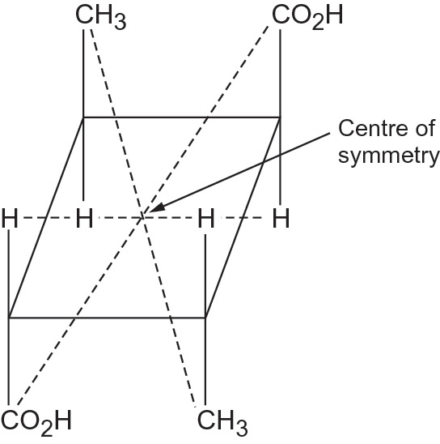
Centre of Symmetry
a point in the molecule through which if a line is drawn in
one direction and extended to equal distance in opposite direction,
it meets another similar group or atom

Slide 22
Sn Alternating Axis of Symmetry
Rotation by angle 360/n about an axis followed by
Reflection in a plane perpendicular to the axis
Meets identical mirror image

Slide 23
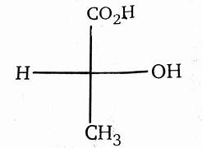
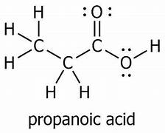
Chirotopic & Achirotopic center
Chirotopic center is one which resides in a chiral environment,
in lactic acid, all groups & atoms are chirotopic
Achirotopic center is one which resides in an achiral environment,
ie contains any one symmetry element
in propanoic acid, all atoms & groups are achirotopic as they are reside
in a achiral environment.
Lactic acid

Slide 24
Stereogenicity & Chirotopicity
Stereogenecity and Chirotopicity are two distinct characters of an asymmetric atom, Stereogenecity is dependent on bonding connectivity but chirotopicity is determined only by local symmetry.
Stereogenicity occurs by producing a different isomer on exchange of any two atoms in the center. A chirotopicity atom is one which resides in a chiral environment.
Stereogenecity and chirotopicity may not coincide in many centers. In Lactic acid, carbon atom is chirotopic as well as stereogenic but the groups H, OH, CH3, COOH are chirotopic but non-stereogenic.

Slide 26
How many stereoisomers exist?
The maximum number of stereoisomers that can exist is equal to 2^{n}
where n is the number of tetrahedral stereogenic carbons in the molecule.

Slide 27
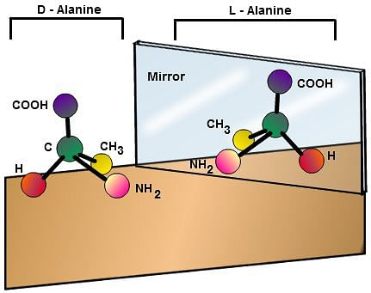
enantiomer
Enantiomers are chiral molecules that are mirror image of one another
Enantiomers have same physical properties except specific rotation
Interchange of any two groups in one Enantiomer
produces the other Enantiomer

Slide 28
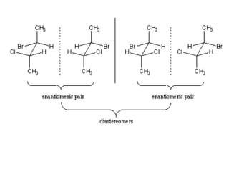
Diastereomers
Stereo isomers that are not mirror image of each other
They have different physical properties like m.p., b.p., solubility, r.i.
Diastereomers have different specific rotation
but they may have same or opposite sign of rotation
I II III IV
Enantiomers
Enantiomers
Diastereomers
I & III, I & IV, II & III, II & IV

Slide 29
Tartaric acid
2 Chiral Centers
I II III IV
I & II Enantiomers
I & III, II & III Diastereomers
III = IV Optically inactive
Meso Isomer

Slide 30
Geometrical Isomerism
occurs when atoms or groups arranged differently in space
due to restricted rotation of a bond or molecule
(double bond or cyclic compound)
Geometrical isomers differ mainly in physical properties
like, b.p., m.p., solubility, dipole moment & r.i.

Slide 31
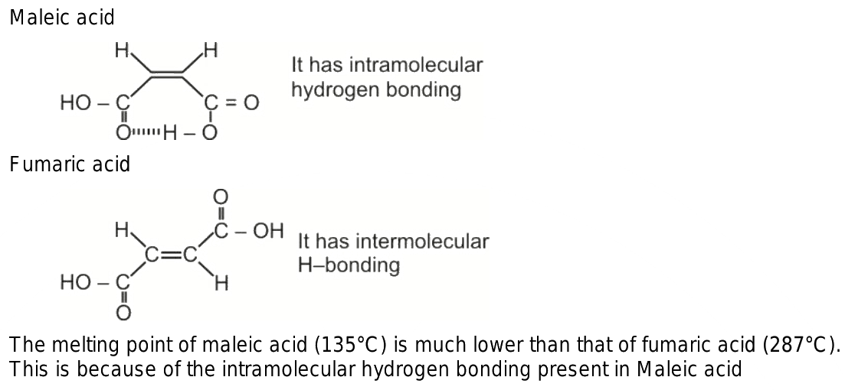
Cis-Trans Nomenclature
Maleic acid - Cis
Maleic acid gives anhydrous
on heating
Fumaric acid - Trans
Fumaric acid does not gives
Anhydrous on heating

Slide 32
Limitations of Cis - Trans nomenclature
Cis-Trans nomenclature is not applicable for molecules
containing
four different connective substituents E / Z
C=N which contain three different connective substituent
Syn / Anti

Slide 33
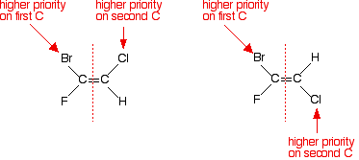
E / Z Nomenclature
Z - from German word Zusammen meaning together
Higher priority groups on the same side
E – from German word Entgegen meaning opposite
Higher priority groups on the opposite side
Z
E

Slide 34
Syn / Anti Nomenclature
Aldoxime
Primary groups
H and OH in the
Opposite side
of C=N
Primary groups
H and OH in the
same side of C=N
Syn
Anti

Slide 35
Syn / Anti Nomenclature
Ketoxime
Higher priority
Group Et and
OH in the same
side of C=N
Higher priority
Group Me and
OH in opposite
Side of C=N
Syn
Anti

