Slide 1
VIDYANAGAR COLLEGE CHEMISTRY DEPARTMENT
FOOD ADULTERATION
&
DETECTION
Dr. Palas Das

Slide 2
FOOD ADULTERATION
Addition of any substance to food
Adversely affects the Nature, Substance and Quality of the food
Elimination of any substance from food
Adulteration includes mixing, substitution, concealing the quality, putting up decomposed food for sale, misbranding or giving false labels & addition of Toxicants

Slide 4
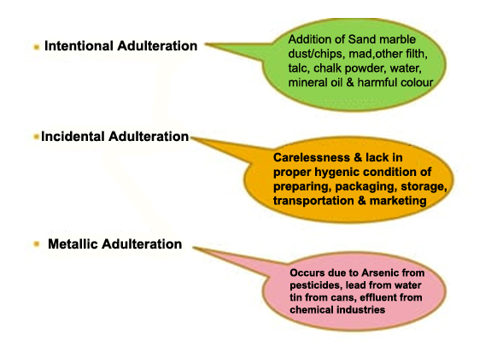
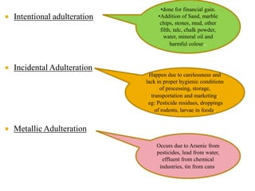

Slide 5
Intentional or Unintensional
Inferior Quality
Consumer Awareness
Cheating & Punishment
Profit Making
Health hazards
ADULTERATION
A LEGAL OFFENCE

Slide 6
FOOD ADULTERANTS vs FOOD ADDITIVES
Antioxidants
Bulking Agents
Emuisifier / Stabilizers
Acid Regulators
Preservatives
Flavour Enhancer
Artificial Sweetner
Glazing Agents

Slide 8
Added Colour must be below 0.2mg /Kg of food
Permitted Colours
Carotene
Chlorophyll
Caramel
Annatto
Tartrazine
Sunset yellow FCF
Carmoisine
Erythrosine
Brilliant blue FCF
Non-Permitted colours
Rhodamine
Orange G
Amaranth
Fast Red
Metanil yellow

Slide 9
PRESERVATIVES
Class I Preservatives
Sugar, Common Salt, dextrose, sucrose, syrup, vineagar, honey & edible vegetable oil
Class II Preseravatives
Not more than one Class II preservative is permitted
No Nitrate / Nitrite Preservative is permitted in infant food
Benzoic acid & salt, Sulphurous acid & salt, Sorbic acid & salt, Nitrate & Nitrite of Na,K Methyl diacetate,
Lactic acid & salt

Slide 10
FOOD ADDITIVES
Synthetic Colours used in food items are harmful
Tartazine – a synthetic lemon yellow azo dye
Colouring agents cause asthma, itching, runny nose
Saccharin and Cyclamate used as Artificial Sweetner in food industry
Artificial Sweetner may cause cancer of urinary bladder
Nitrites & Nitrates used as Preservatives in packaged meat
Preservatives may cause stomach & gastro intestinal cancer

Slide 11
FOOD ADDITIVES
Mono-sodium glutamate (MSG) or Azinamoto -
A protein flavour enhancer commonly used in fast
food & Chowmine. It causes severe headache, nausea, burning sensation, asthmatic attack, long term use damage to brain
Sodium metabisulphite and Sulphur dioxide used as Preservatives for fruits and vegetables,wines,beers to
prevent discolouration and spoilage. Consumption
may cause breathing & heart problem

Slide 12
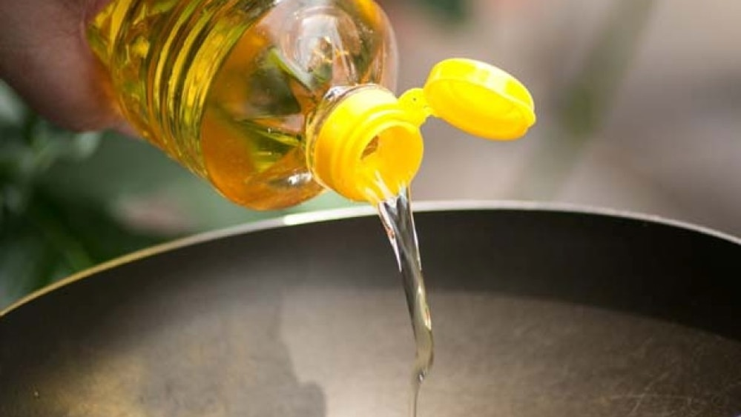
FOOD ADULTERATION
AN UN-ETHICAL PRACTICE
Adulteration may cause serious health problem even death
Mustard Oil mixed with
Argemone oil causes
epidemic dropsy, Glucoma
Adulteration of edible oil with
Trycresyn phosphate (TCP)
Causes paralysis & death
PANNA OIL MILL, BEHALA
Adulteration left over 25 death in 1988

Slide 13
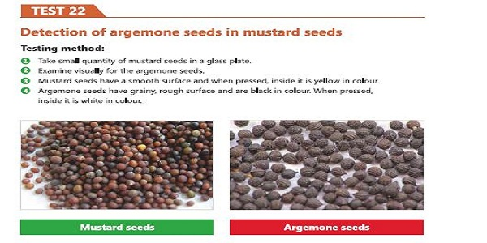
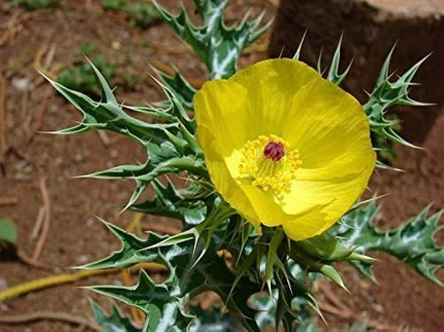

Slide 14
Common adulterants of MILK & side effect
Adulterant | Used for | Adverse effect
Water | Increase the milk volume | Decreases the nutritive value & health hazards to children
Benzoic & Salicylic acid | Increases shelf life for long distance transport | Linked to asthma & increases level of hyper-activity of children
Detergents | Increases foaming in milk & also whiteness, thickness | Causes Gastro intestinal & renal problems
Urea | Increases whiteness, thickness & consistency | Kidney damage & renal failure
Formalin | Increases shelf life | Liver & kidney damage
Starch | Increases Solid not Fat percentage (SNF) | Causes diarrhea, may be fatal for diabetics

Slide 15
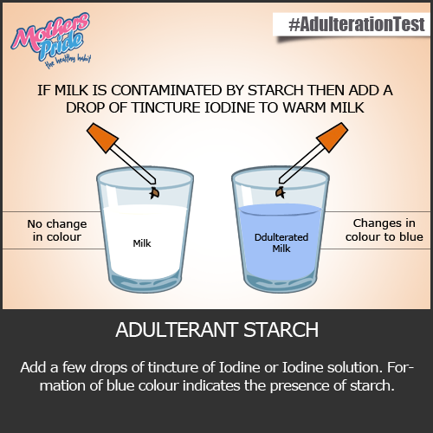
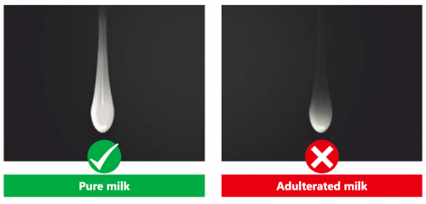
Tests for Adulterated Milk

Slide 16
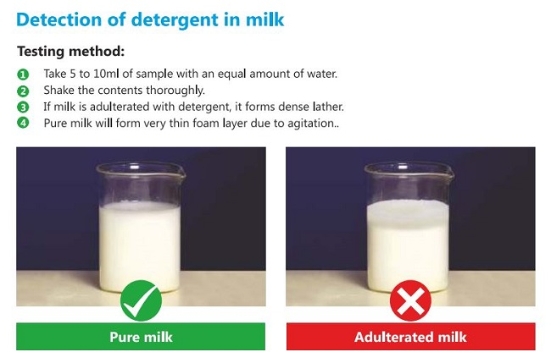

Slide 17
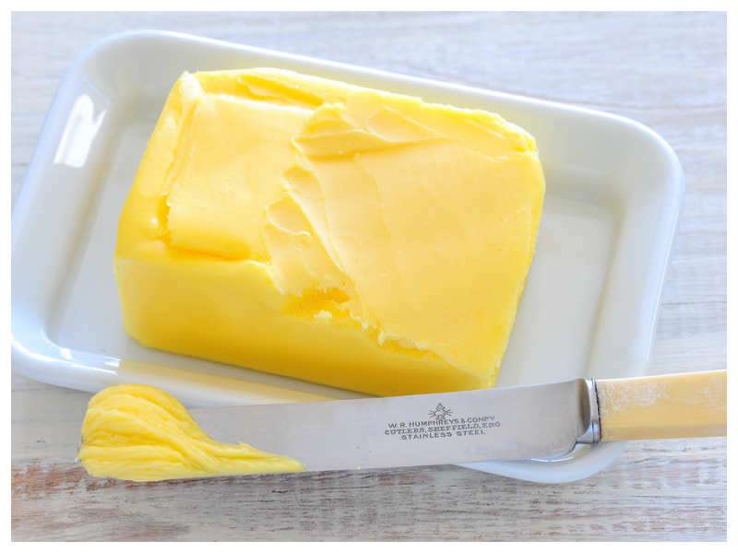
GHEE / BUTTER
Adulterants
Ghee essence used in cheaper oil & passed off as pure
Ghee. This type of ghee will not solidify like normal
Ghee & also not have the grainy texture of pure ghee
Oleomargarine or lard ( animal fat) added to butter
Mashed potatoes, sweet potatoes, or other starch is
added to ghee
Health effect :
Cancer or acute renal failure
The argemone oil used to adulterated ghee causes
dropsy (fluid collection in some parts of the body)

Slide 18
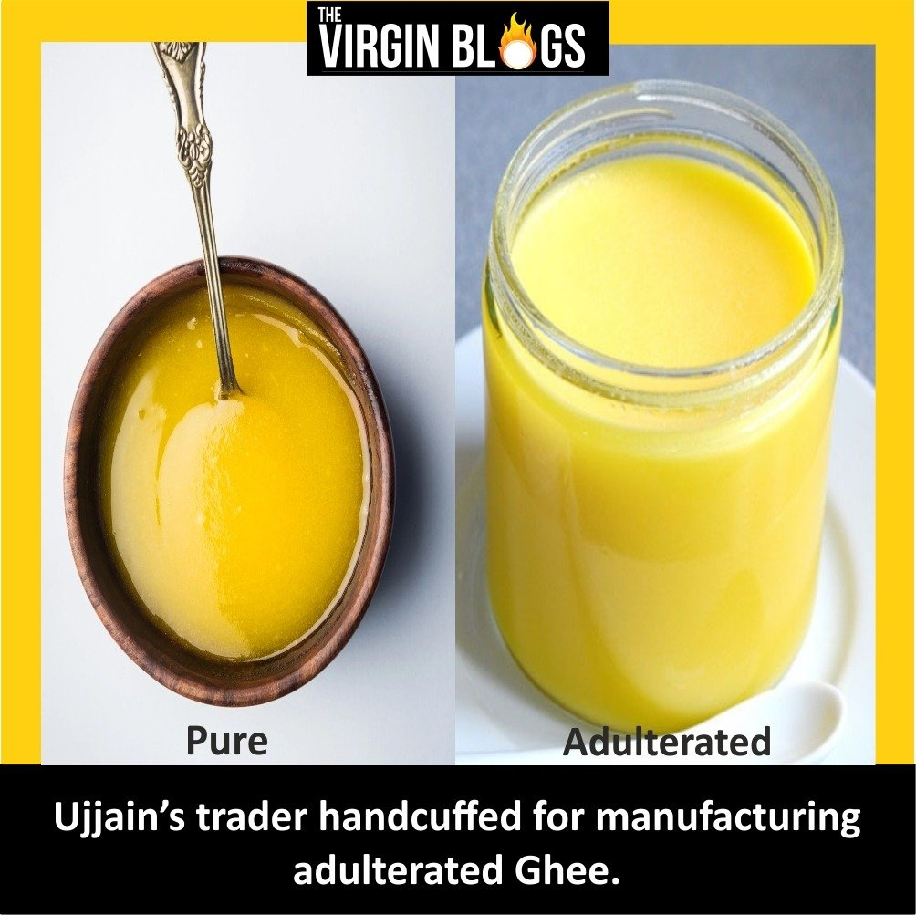

Slide 19
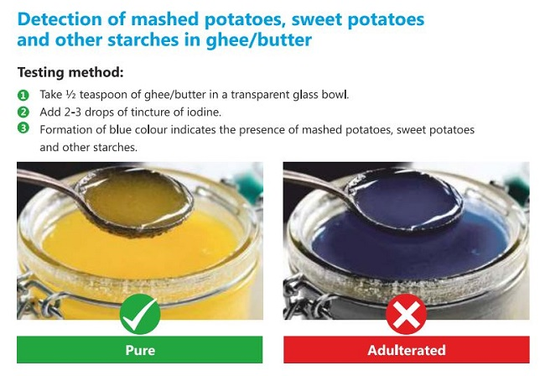

Slide 20
SUGAR / COMMON SALT
Adulerants
Chalk powder, white sand, washing soda, Urea, colour,
stones, rawa / suji
Chalk powder may cause respiratory
problem
Washing soda cause diarrhea, nausea,
vomiting

Slide 22
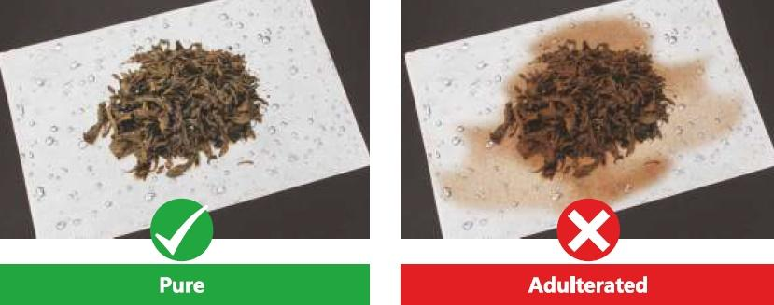
TEA
Common Adulterants
Used tea leaves, dye or artificial colour, iron fillings
Health effects : Cancer

Slide 23
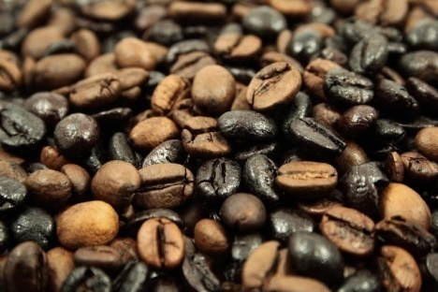
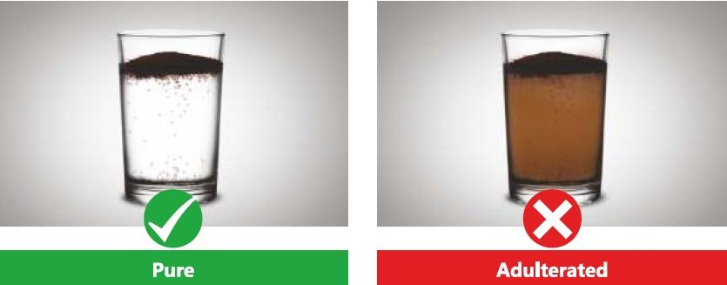
COFFEE
Coffee is adulterated with chicory powder,
ground tamarind
Health effects : causes stomach disorder,
giddiness, joint pain

Slide 24
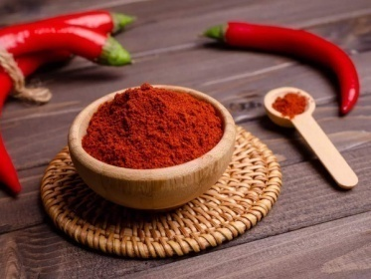
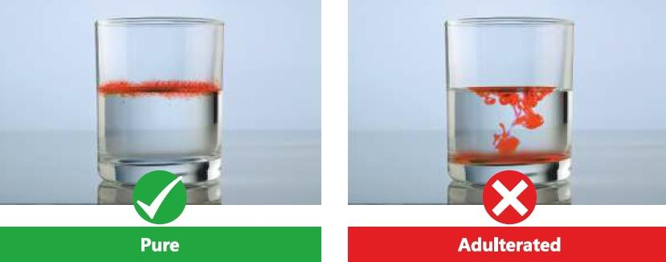
RED CHILLI POWDER
Adulterants : Sudan red, Rhodamine B colour,
red brick powder, Saw dust sand, dirt
Health effects : Cancer, stomach disorder

Slide 25
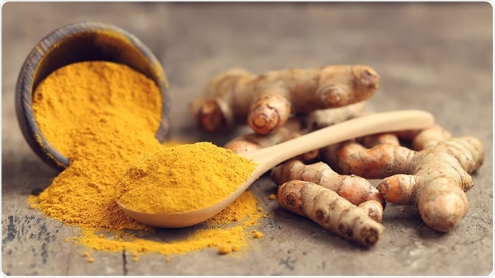
TURMERIC POWDER
Adulterant : Lead chromate, Metanil
Yellow, sudan red artificial colour
Health effect : Cancer, Lead chromate
can cause anemia, paralysis

Slide 26
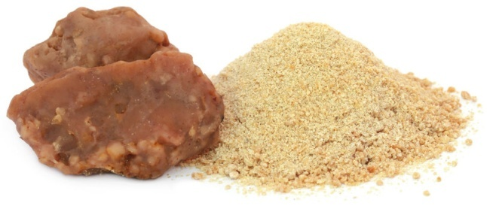
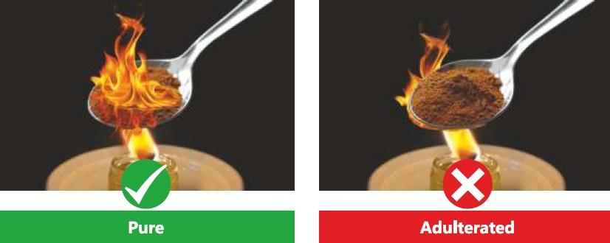
ASAFOETIDA ( HING )
Adulterants : Starch, resin, soap stone or saji mati
Health effects : Stomach disorder, nausea

Slide 27
SWEETS & DESERTS
Food colour like metanil yellow beyond the safety
limit can cause allergies, hyperactivity, liver damage,
infertility, anemia, cancer & even birth defects

Slide 28
ADULTERATION IN
POULTRY & FISH
FORMALIN – used to keep the fish looking fresh
Formalin can cause health conditions such as abdominal discomfort, vomiting, renal injury,
Unhygenic meat & meat products can cause stomach
infection,dehydration usually with fever & chills
Mercury adulterated fish can cause brain damage, paralyses & death

Slide 29
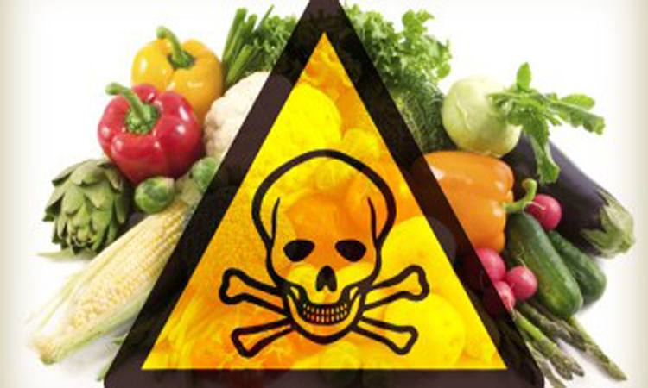
Unethical Adulteration
A SOCIAL EVIL
A very common practice
in our country
Adulteration cases increasing due to few legal control
in food quality and poor, non-existing monitoring
by regulatory authorities

Slide 30
PREVENTION OF FOOD ADULTERATION ACT, 1954
PFA Amended by Indian Parliament in 1964, 1976 & 1986
Objectives :
Preventing import, manufacture, distribution & sale of all adulterated food
Ensuring Pure & wholesome food to the consumer
Protect the consumer from fraudulant & deceptive trade practice
Case of Proven Adulteration
Cause of Death & Health hazards
6 month Imprisonment & Fine Rs. 1000
Life Imprisonment & Fine Rs. 5000

Slide 31
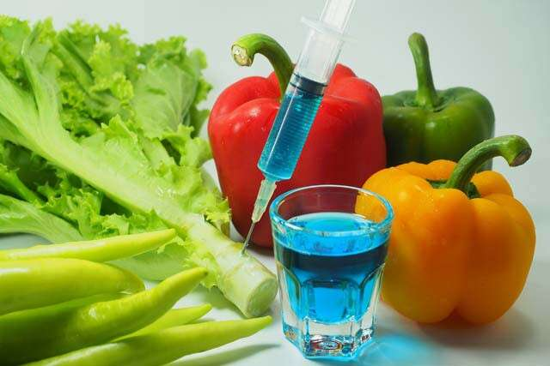
ADMINISTRATIVE BODIES
FOR PFA ACT
CENTRAL COMMITTEE FOR FOOD STANDARDS
CENTRAL FOOD LABORATORIES
PUBLIC ANALYST
FOOD INSPECTOR

Slide 32
Central Committee for Food Standards
Chairman : Director General of Medical Health Services, Govt of India
Any no. of members related to Health, Food, Analysis
Functions : can frame by-laws, constitute Committees & advice Central /State Government on matters relating food standards

Slide 33
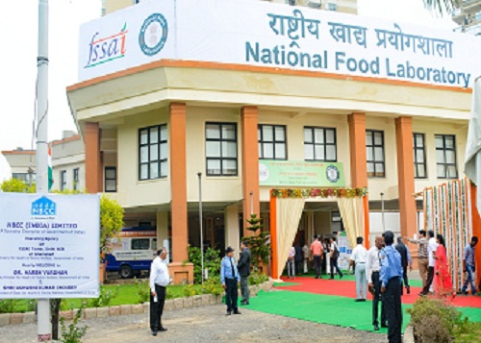
Central Food Laboratories, Govt of India
Government established four laboratories for food analysis at Kolkata, Gaziabad, Mysore & Pune
Functions:
a) Fixation of standards and quality control parameters for food articles
b) Collaboration work with State laboratories for analysis & standards

Slide 34
PUBLIC ANALYST
Appointed by State / Central Govt
On receipt of sample Public Analyst confirms the
authenticity of the sample by comparing the seal on it
Keeps the sample in safe custody before, during & after
Analysis and preserves it for submission into court
Records analysis using approved methods, records the
Findings and inform the Food Inspector
Keeps in touch with Central Food Laboratories for
consultation & dissemination of knowledge

Slide 35
FOOD INSPECTOR
Appointed by State / Central Gogernment
Medical Officer in charge of local Health Administration
1 To inspect License for manufacture, Storage, sale of food
2. To make queries on receipt of complaints about the
quality of the food and conduct inspection
3. To maintain the records of inspection and inform the
higher authorities about the inspection
Food inspector can stop sale, seize food article in public
interest. He can stop any vehicle carrying adulterated or
misbranded food or prohibit manufacture of food

Slide 36
International Food Quality Standard constituted by UN
Standard available for processed & raw food – provide
ideal specification for food additives, contaminants,
Sampling, method of analysis, labelling & hygienic
Requirements for foods

Slide 37
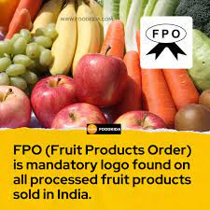
FRUITS PRODUCT ORDER
Advisory committee looks after
Hygiene Requirements during
manufacturing, processing,
container & packaging, labelling
Checks for limits for poisonous
Metals like Pb, Cu, As & Zn
Check for added preservatives
& permissible colours

Slide 38
ISI
AGMARK
Mark of excellent standard set for all products by INDIAN BUREAU OF STANDARDS
Hygiene of manufacture, process, analysis of chemicals & additives, standard method of analysis, equipment specification, standard for processed food product
Standards pertain to agricultural & related products
Prudcts graded as Graded one, two, three & four for special, good , fair & ordinary quality
Checks physico-chemical properties during storage & processing

Slide 39
FOOD SAFETY STANDARDS
AUTORITY OF INDIA
FSSAI Standard authority established in 2006 under the Ministry of Health & Family Welfare, Govt of India
Headed by Chairperson, appointed by the Central Govt.
of not below the rank of Secretary to the Govt of India
FSSAI License or Registration is required for any food
business in India that manufactures, stores, transports,
or distributes food including hotels & restaurents

Slide 40
COPRA 2019

Slide 41
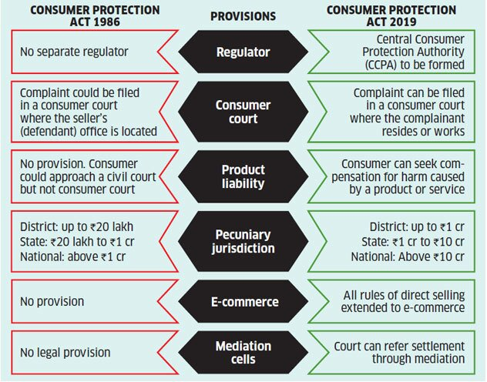

Slide 42
