Slide 1
Issues in International Relations in the Post Cold War Era
The Impact on Indian Foreign Policy
Parthapratim Sen
Dept.of Political Science
Vidyanagar College

Slide 2
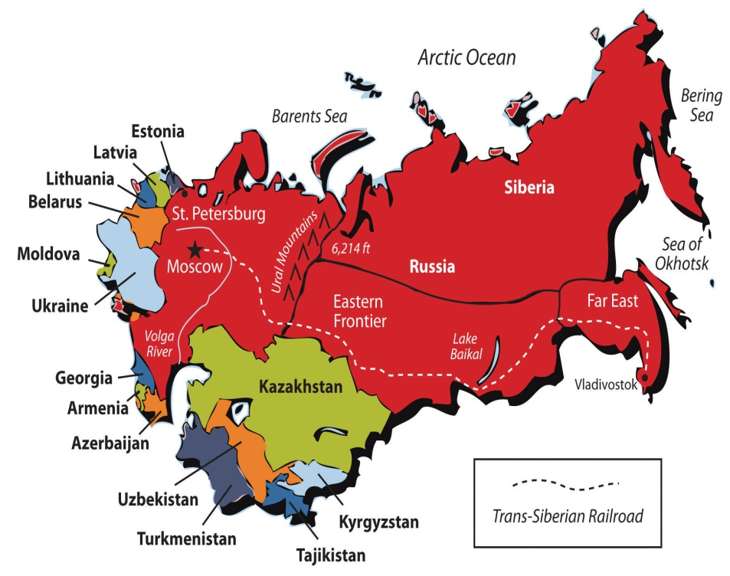
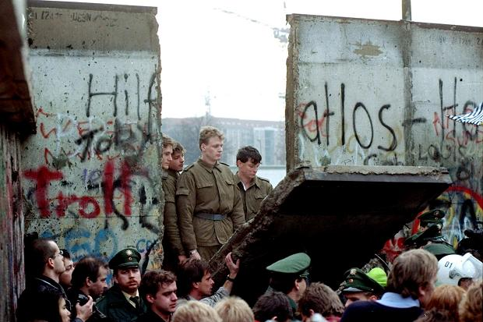
WHICH CAME FIRST ?

Slide 3
Early Post Cold War:1991-2001
New World Order
Ethno-Nationalism in Europe
Uni or Multi-Polarity
UN Peace-Keeping
Terrorism
Globalization

Slide 4
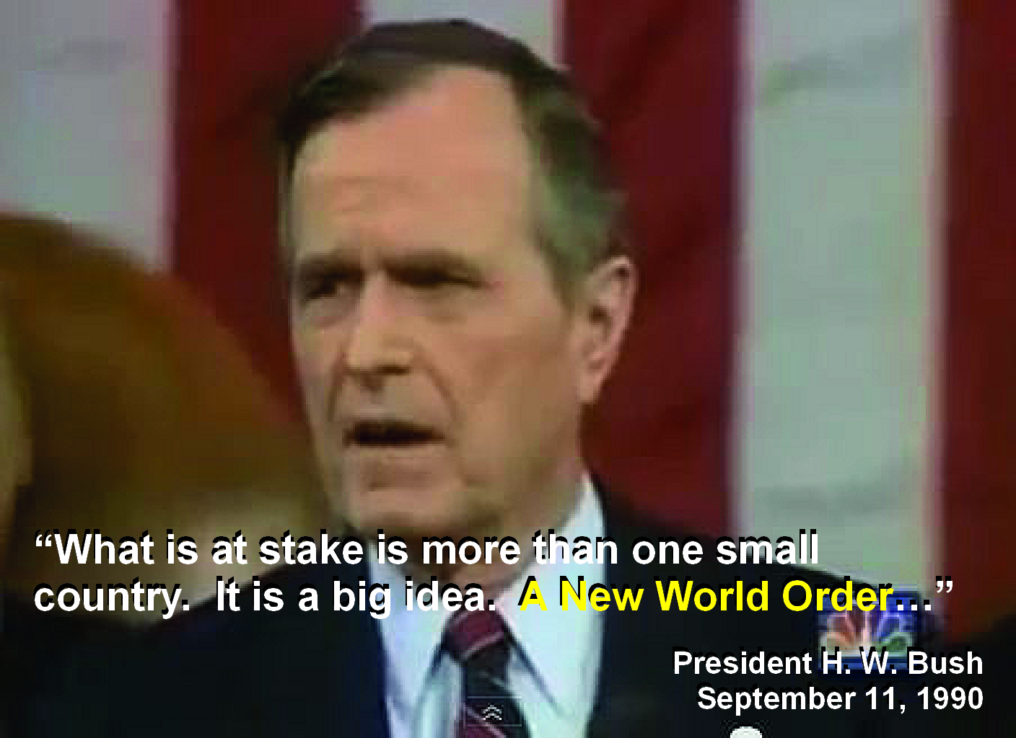
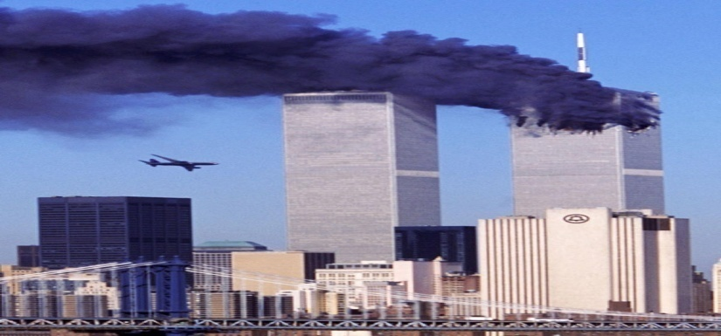
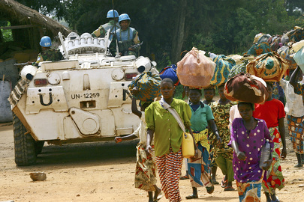
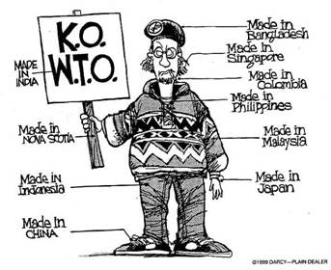

Slide 5
Post Post-Cold War:2001 onwards
War on Terror
Regional and Economic Co-operation Forums
Non-Military Threats to Security

Slide 6
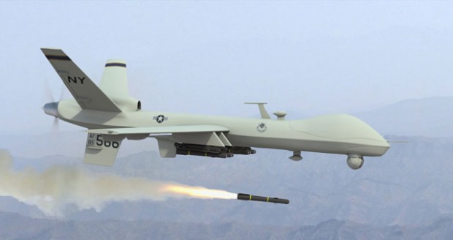
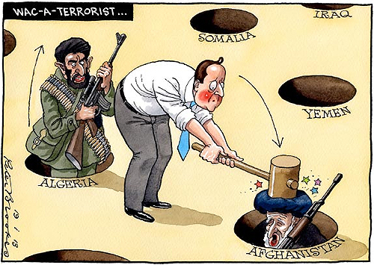
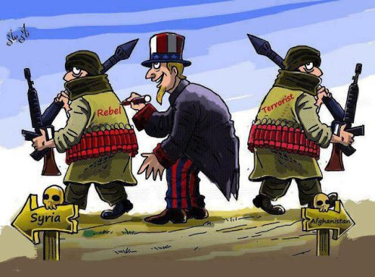
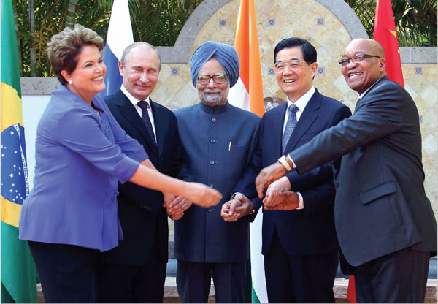
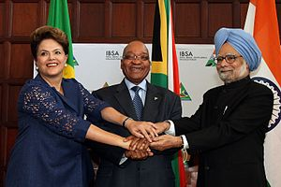
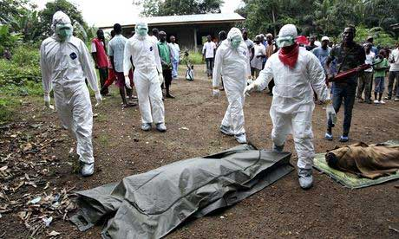
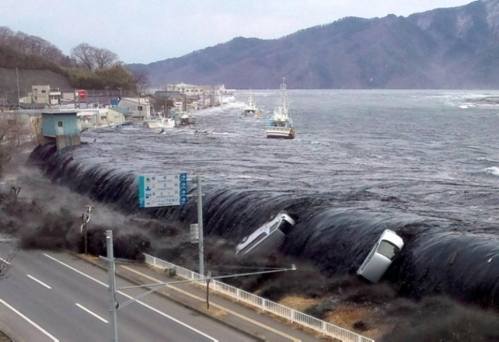

Slide 7
Principles of Indian Foreign Policy
Non-Alignment & Panchsheel
Anti-Imperialism
Anti-Neo-Imperialism
Support for National Liberation Movements
Anti-Discrimination on the basis of Race, Colour etc.
Disarmament
Faith in the Principles of United Nations

Slide 8
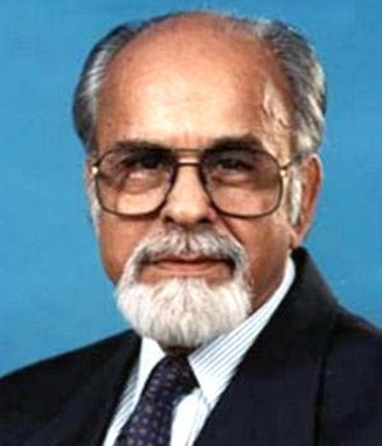
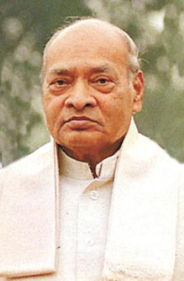
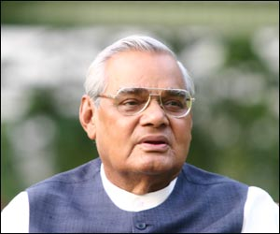
INDIAN FOREIGN POLICY IN THE POST COLD WAR ERA
PRAGMATIST
REALIST
IDEALIST

Slide 9
PRAGMATICISM OF RAO
Restructuring of the Indian Economy
Restructuring of Bi-Lateral Relations
(USA,UK,Israel,European Union, Russia)
Restructuring of the Nuclear Sector

Slide 10
THE GUJRAL DOCTRINE
With the neighbours like Nepal, Bangladesh, Bhutan, Maldives and Sri Lanka, India does not ask for reciprocity but gives all that it can in good faith and trust.
No South Asian country will allow its territory to be used against the interest of another country of the region
None will interfere in the internal affairs of another
All South Asian countries must respect each other’s territorial integrity and sovereignty
They will settle all their disputes through peaceful bilateral negotiations

Slide 11
REALISM OF VAJPAYEE
POKHRAN II
LAHORE BUS DIPLOMACY
KARGIL WAR
AGRA SUMMIT
OPERATION PARAKRAM

Slide 12
FOREIGN POLICY UNDER UPA-I&II
123 Nuclear Deal
Look East Policy
Improvement in Sino-India Relations
Opening of Srinagar-Muzaffarabad Bus Route
Trade Agreements with South Korea, Malaysia Japan
Bali Package

Slide 13
FUTURE FOREIGN POLICY CONCERNS OF INDIA
SOVEREIGNTY IN FOREIGN POLICY FORMULATION
SECURITY-STRATEGIC & HUMAN
REGIONAL STABILITY
FORGING NEWER ECONOMIC ALLIANCES
CONSTRUCTIVE ROLE IN THE U N O
PROMOTION OF WORLD PEACE

Slide 14
THANK YOU

